Slide 1
Design Patterns : Tailor-made Solutions for Software Development
View Design Patterns course details at www.edureka.co/design-patterns
For Queries:
Post on Twitter @edurekaIN: #askEdureka
Post on Facebook /edurekaIN
For more details please contact us:
US : 1800 275 9730 (toll free)
INDIA : +91 88808 62004
Email us : sales@edureka.co

Slide 2
Objectives
At the end of this session, you will be able to:
Know what is Software Design Patterns
Understand the need of Software Design Patterns
Code with Adapter Pattern
Communicate among objects with Mediator Pattern
Distribute Responsibility using Chain Of Responsibility Pattern
Decorate your objects with Decorator Pattern

Slide 3
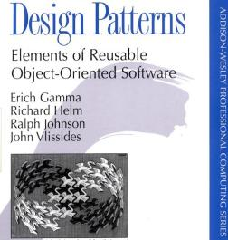
Software Design Patterns & Gang Of Four(GOF)
Software design patterns describe relationship among classes to solve a general and repeatable design problem in a specific context with proven solution
Anyone who knows something about Software Design Patterns will certainly be aware of famous book “Elements of Reusable Object-Oriented Software” written by Erich Gamma, Richard Helm, Ralph Johnson and John Vlissides popularly knows as Gang Of Four(GOF)
This is the most popular book written on Software Design Patterns by Erich Gamma, Richard Helm, Ralph Johnson and John Vlissides, known as Gang Of Four

Slide 4
Classification of Software Design Patterns
Software Design Patterns
Factory Pattern
Object Pool Pattern
Structural Design Pattern
Adapter Pattern
Decorator Pattern
Creational Design Pattern
Singleton Pattern
Composite Pattern
Behavioral Design Pattern
Chain of Responsibility Pattern
Mediator Pattern
ObserverPattern
.
.
.
.
.
.
.
.
.

Slide 5
Importance of Design Patterns
Just knowing a Programming Language is not enough to engineer a software application
While building an application its important that we keep the future requirements and changes in mind otherwise you will have to change the code that you had written earlier
Building a large application is never easy, so its very important that you design it correctly and then start coding the application
Design Patterns provides efficient techniques to create a flexible application design

Slide 6

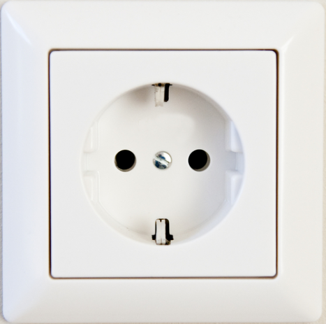

Adapter Pattern
Adapter Pattern converts interface of a class into another interface
Adapter Pattern lets two incompatible interfaces work together
For example European sockets are circular and American plugs are rectangular, now to plug an American rectangular plug into European circular socket you need an adapter
Adapter

Slide 7
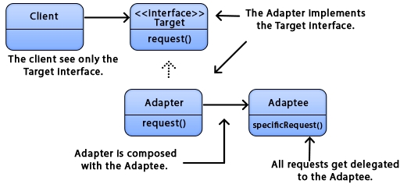
Adapter Pattern – UML Diagram

Slide 8
Problem Statement
Application development confines working with various third party APIs
There are lots of cases where the client code can not directly work with third party API because it provides a different interface then what your client code expects
For example suppose there is lot of client code already written using Enumeration, but you need to use a third party API that uses Iterators rather than Enumeration
Solution
One solution is to change entire client code to target interface
Other solution is to use an Adapter that adapts client code to target interface without changing any previous code

Slide 9
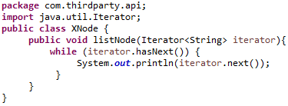
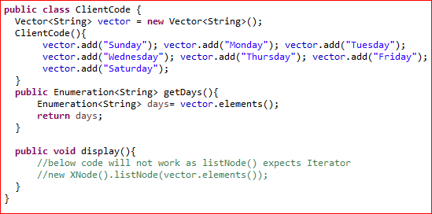
Implementing Adapter Pattern
Third Party API uses Iterator
Client Code is written using Enumeration

Slide 10
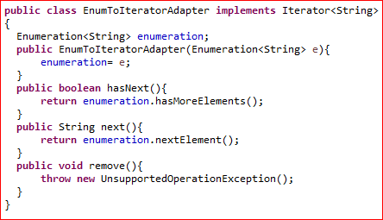
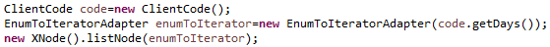

Implementing Adapter Pattern (Contd.)
Adapter adapts Enumeration to Iterator
Adapter implements the target interface (Iterator)
While using Adapter pattern we don’t change client code or third party code

Slide 11
Decorator Pattern
Decorator pattern refers to creation of wrapper to original object by providing extra functionalities to it
While the same functionality can be achieved by using sub-classes, it is not a preferred approach where there is a need to add same kind of functionality to lot of different object, it increases the number of subclasses and creates a memory over-head
You can use the same decorator to decorate different objects

Slide 12
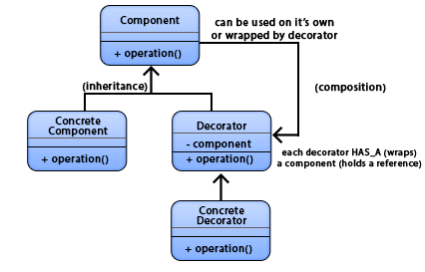
Decorator Pattern - UML Diagram
Decorators implement the same interface or abstract class as the component they are going to decorate
ConcreteComponent is the object we are going to dynamically add new behavior to. It extends Component

Slide 13
Understanding Decorator Pattern
Suppose you have to design a CoffeeShop application. One of the simplest design would be as below:
Beverage abstract class and specific coffee classes extending from that abstract class
Beverage
DarkRoast
Espresso
Cappuccino
Each coffee can be decorated with extra milk or soy or mocha etc

Slide 14

Understanding Decorator Pattern (Contd.)
This approach is bad as you have to create a separate concrete class for each Coffee and decorator combination
And as milk prices changes you have to change the cost of each Coffee that is decorated with Milk
DarkRoast
DarkRoastWithMocha
DarkRoastWithMilk
DarkRoastWithSoy
Espresso
EspressoWithSoy
EspressoWithMilk
EspressoWithMocha
Cappuccino CappuccinoWithMocha
CappuccinoWithMilk
CappuccinoWithSoy
This design is static as it does not reuse the decorators(milk, soy, mocha) and will result in a large number of subclasses

Slide 15
Understanding Decorator Pattern
This design can decorate a beverage with milk, soy and mocha dynamically
Beverage
DarkRoast
Espresso
Cappuccino
Decorator
Milk
Soy
Mocha

Slide 16
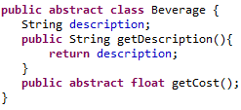
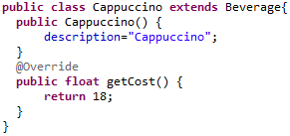
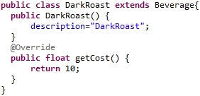
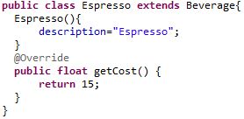
Implementing Decorator Pattern

Slide 17
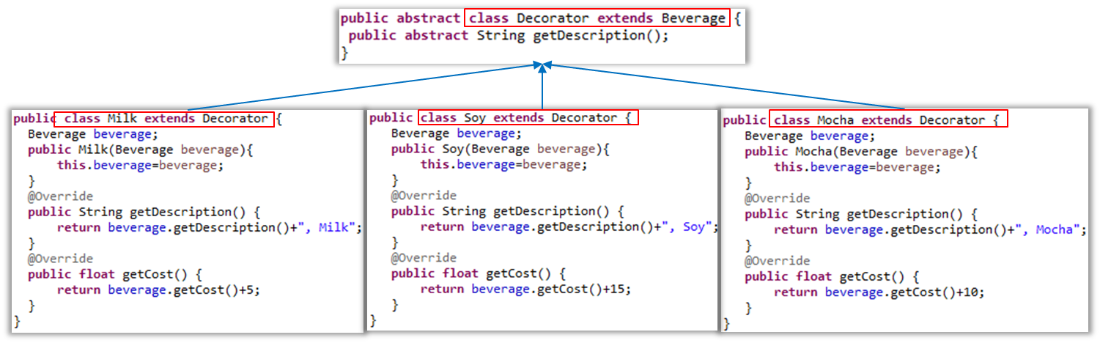
Implementing Decorator Pattern (Contd.)

Slide 18
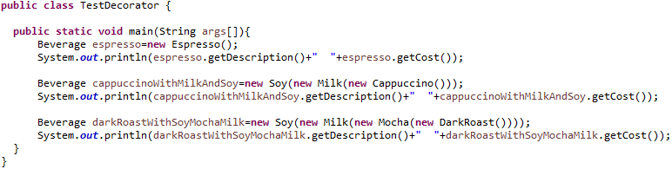
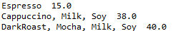
Testing Decorator Pattern
No decoration
Output
Decoration with Soy and Milk
Decoration with Soy, Milk and Mocha

Slide 19
Understanding Decorator Pattern
java.io package makes extensive use of Decorator pattern. Each decorator adds new functionality to the underlying class to which it is applied
OutputStream have similar API as InputStream
InputStream
FileInputStream
ObjectInputStream
FilterInputStream
ByteArrayInputStream
BufferedInputStream
DataInputStream
LineNumberInputStream

Slide 20
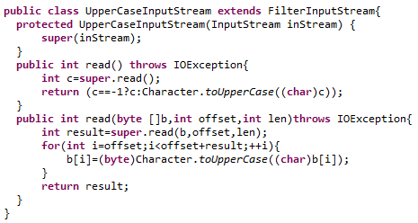
Writing a Java IO Decorator
Below class decorate the input stream, such that each character read from input stream will be return in uppercase

Slide 21
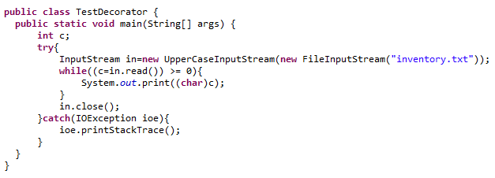
Testing our Java IO Decorator
FileInputStream is decorated with UpperCaseInputStream which will return each character read from inventory.txt in upper case

Slide 22

Chain of Responsibility (COR)
Chain Of Responsibility pattern gives more than one object a chance to handle the request
Sender of the request does not know which object in the chain will serve its request
In Chain Of Responsibility pattern a chain of request handlers is maintained, a handler decides whether it can handle the request or not, if not then it passes the request to next handler
Chain of Receiver
Request
Request
Request
Request
Receiver 1
Receiver 2
Receiver 3
Receiver N
Reference to Receiver 2
Reference to Receiver 3
Reference to Receiver 4
Cannot handle

Slide 23
Chain of Responsibility - UML Diagram
Handler - defines an interface for handling requests
ConcreteHandler - handles the requests it is responsible for .If it can handle the request it does so, otherwise it sends the request to its successor
Client - sends commands to the first object in the chain that may handle the command
Client
Handler
+HandleRequest()
ConcreteHandler1
+HandleRequest()
ConcreteHandler2
+HandleRequest()

Slide 24

Problem Statement
Customer support system is one of the implementation of this pattern, where users calls the help desk (L1 support) and tell their problem
Resolved
YES
NO
Resolved
YES
NO
Cannot handle
Problem Statement
L1 Support
L2 Support
Request goes through multiple objects (handlers)

Slide 25
Solution
Using Chain of responsibility simplifies the request object because it does not have to know the chain’s structure and keep direct references to its members
In this case, user simply interact with help desk and the request internally goes through multiple handlers
User does not need to know about the different handlers

Slide 26
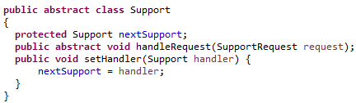
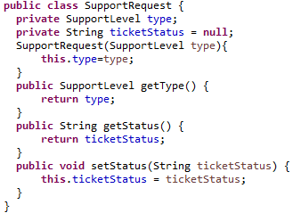
Implementing Chain of Responsibility
All support levels will have to inherit the support class and implement the handleRequest()
Client (user) will generate a SupportRequest (a ticket)

Slide 27
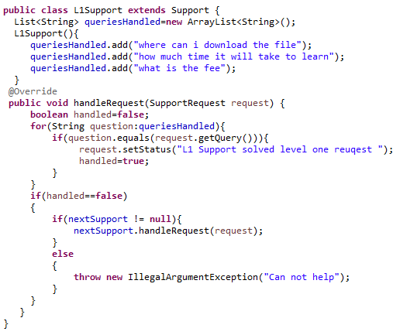

Implementing Chain of Responsibility (Contd.)

Slide 28
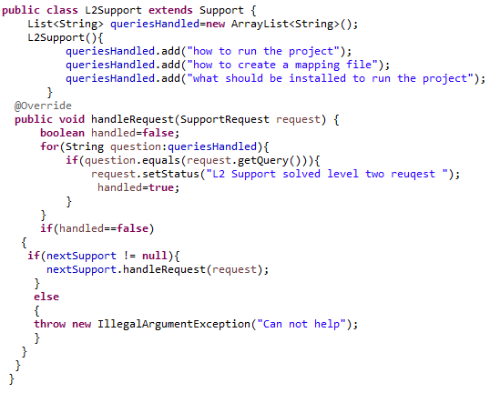
Implementing Chain of Responsibility (Contd.)

Slide 29
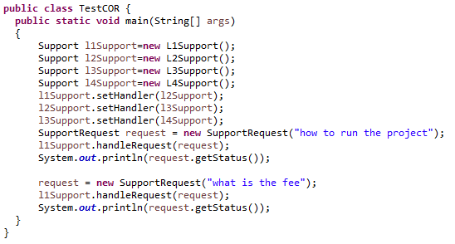
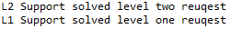
Implementing Chain of Responsibility (Contd.)
Here we are creating chain of responsible objects for handling the support request according to user query
Output
All the support requests will first go to L1 support

Slide 30


Other Uses Of Chain of Responsibility
One of the most important use of Chain Of Responsibility pattern is to implement filter mechanism
Here one filter process the request and then passes on to next filter in the chain, similarly next filter processes the request and then passes onto next filter in chain
JavaEE API uses Chain Of Responsibility pattern to implement filter mechanism using the following doFilter() method
javax.servlet.Filter#doFilter(ServletRequest request, ServletResponse response, FilterChain chain)
Request
Servlet
Logging Filter
Authentication Filter
JAX-WS also uses Chain Of Responsibility pattern to implement JWS Handler Framework, which allows manipulation of SOAP messages

Slide 31

Mediator Pattern
The mediator pattern promotes loose coupling of objects by removing the need for classes to communicate with each other directly
Instead, mediator objects are used to encapsulate and centralize the interactions between classes
Mediator pattern simplifies communication in general when a program contains large number of classes that interact
Each class only needs to know how to pass messages to its mediator, rather than to numerous colleagues

Slide 32
Mediator Pattern – UML Diagram
Mediator - defines an interface for communicating with Colleague objects
ConcreteMediator - knows the colleague classes and keep a reference to the colleague objects
Colleague classes - keep a reference to its Mediator object
Mediator
Colleague
ConcreteMediator
ConcreteColleagueA
ConcreteColleagueB

Slide 33

Problem Statement
Suppose you have to create a chat application where multiple users can chat together
Rather than each user sending the message directly to other users, we can use mediator pattern to implement this design

Slide 34
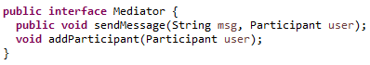
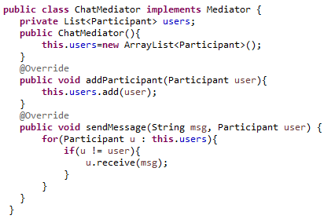
Implementing Mediator Pattern
ChatMediator keeps the reference of all the users

Slide 35
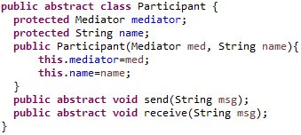
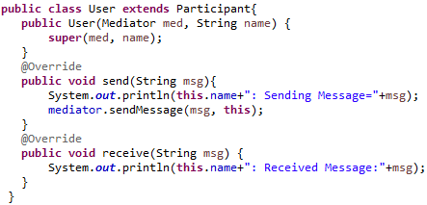
Implementing Mediator Pattern (Contd.)
A User doesn’t have any reference to other users

Slide 36
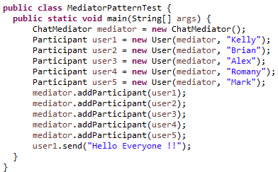
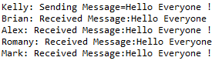
Implementing Mediator Pattern (Contd.)
Output

Slide 37
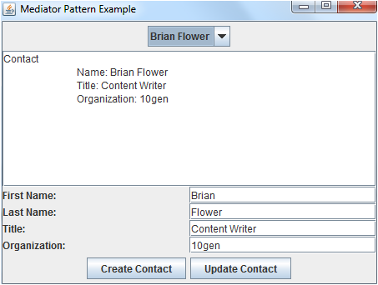
Implementing Mediator Pattern (Contd.)
All GUI applications consists of small components like Windows, Panel etc.
Each Panel contains a group of GUI element
These panels have to co-ordinate among themselves
As in this application, whenever a contact is selected from the drop down box, its details should be updated in the ContactDisplayPanel and ContactEditorPanel
Rather then one panel having reference of all other panels, we can use Mediator Pattern to simplify the communication between panel objects
ContactSelectorPanel
ContactDisplayPanel
ContactEditorPanel

Slide 38
Conclusion
Similarly there are other design patterns to solve majority of the problems that software designers encounter during their day to day activities
Design patterns compliments ones experience and helps them deliver wonderful and successful software designs
They serve as common nomenclature or jargon that architects can easily communicate with others in software industry
Software design is no more an art. It’s a skill one can learn. And thanks to design patterns

Slide 39
Course Topics
Module 5
Concurrency Design Patterns
Module 6
Anti Patterns
Module 7
Refactoring
Module 8
Project and Retrospection
Module 1
Introduction to Design Patterns
Module 2
Creational Design Patterns
Module 3
Structural Design Patterns
Module 4
Behavioral Patterns

Slide 40
How it Works?

